Slide 1
Software Reuse
Soon Phei Tin - 2025

Slide 2
Topics
Introduction to Software Reuse
Benefits and Challenges of Software Reuse
Key Software Reuse Strategies: -
Application Framework
Software Product Lines
Commercial Off-The-Shelf

Slide 3
Introduction to Software Reuse
Why software reuse matter?
Companies like Google and Netflix save millions by reusing code. Today, we will learn how to do the same
Definition: Software reuse is the practice of using existing software components (code, designs, etc.) to build new system

Slide 4
Introduction to Software Reuse
Real-world impact: -
Faster development
TensorFlow powers multiple AI tools at Google
Google Launches TensorFlow Enterprise at No Extra Cost for Cloud Customers
Fewer bugs
React’s reusable components reduce errors across Meta’s platforms
Facebook, Instagram, and WhatsApp
Why it’s exciting: Reuse isn’t just efficient – It’s key skill in modern software engineering

Slide 5
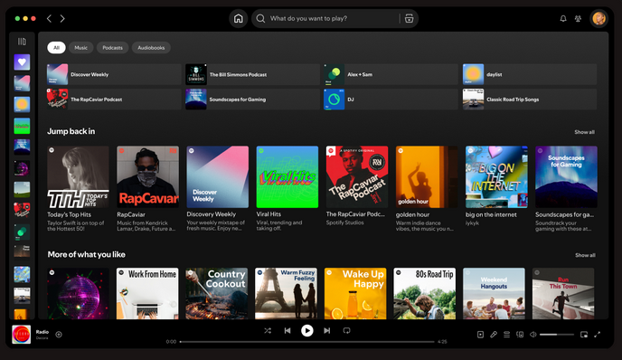
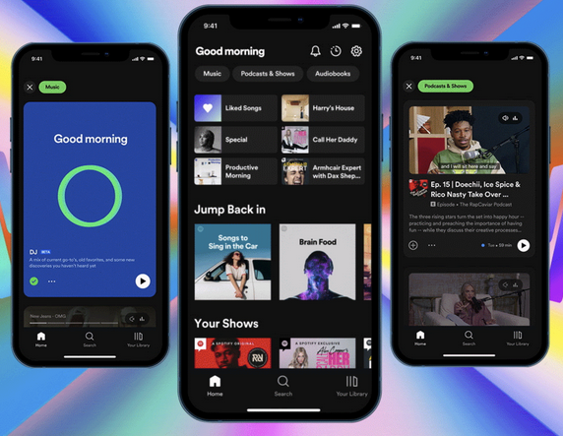
Benefit of Software Reuse
Why it saves time and money?
Key benefit:
Cost savings: Reuse reduces development and maintenance cost
Faster delivery: Get products to market quicker
Higher quality: Tested components mean fewer bugs
Specialist knowledge: Leverage experts’ work without reinventing the wheel
Example: Spotify reuses UI components across its web and mobile apps for consistency and speed

Slide 6
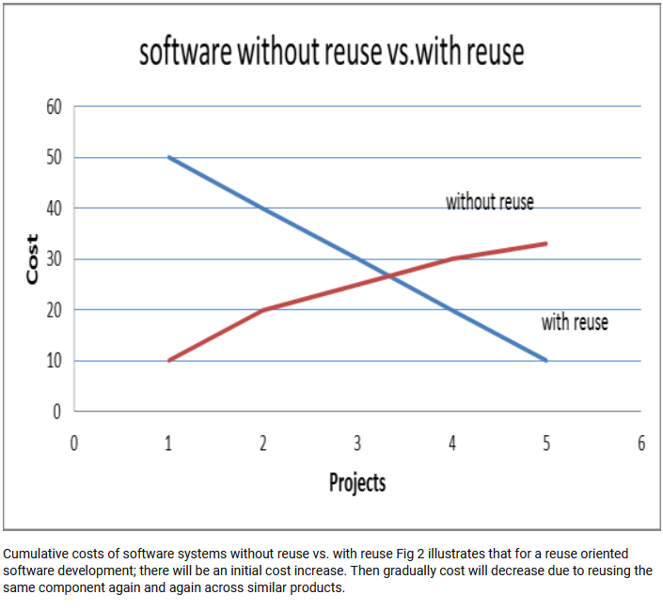
Velumani, P. Mangayarkarasi & Rangasamy, R.Selvarani. (2021). A Novel Software Cost Estimation Technique: Inclusion of Reusability.

Slide 7
Challenges of Software Reuse
Why reuse isn’t always easy?
Key challenges:
Maintenance costs: Reuse code may become outdated or incompatible
Tool support: Some tools don’t integrate well with reuse components
Not-invented-here syndrome: Developers may resist using others’ code
Finding and Adapting components: It can be hard to locate and modify the right components
Can you think of a time when reusing something didn’t work out?

Slide 8


Challenges of Software Reuse
Example:
Ariane 5 Flight 501 (1996): The Ariane 5 rocket exploded 40 seconds after launch due to a software error. The software reused a component from the Ariane 4 rocket without proper adaptation
https://www.youtube.com/watch?v=N6PWATvLQCY
(credit: ESA)
(credit: ESA)

Slide 9


Challenges of Software Reuse
Example:
Knight Capital Group (2012): Knight Capital Group deployed new trading software that reused old code from a previous system. The old code was not properly deactivated, leading to a series of erroneous trades.
Outcome: The company lost $440 million in just 45 minutes and nearly went bankrupt. This incident highlighted the risks of reusing legacy code without proper integration and testing.
Jin Li | Bloomberg | Getty Images
by Bishr Tabbaa

Slide 10
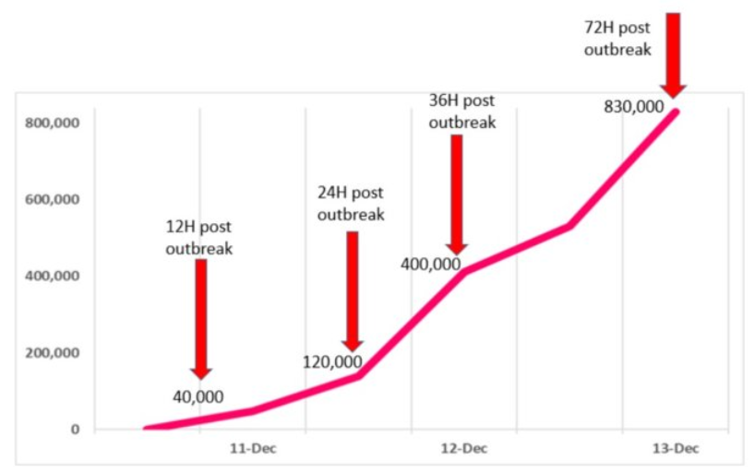
Challenges of Software Reuse
Example:
Log4j Vulnerability (2021): The Log4j library, a widely reused open-source logging tool, had a critical vulnerability (CVE-2021-44228) that allowed remote code execution. Many organizations had reused Log4j in their systems without fully understanding its dependencies
(credit: Check Point)

Slide 11


Slide 12
Core Reuse Techniques
Key approaches:
Application framework: Pre-built structures (e.g. Django, Spring) that you extend.
Software produce lines (SPL): Families of similar products with shared components (e.g. Salesforce CRM variants)
COTS (Commercial Off-The-Shelf): Ready-made software adapted for specific needs (e.g. WordPress for websites)
Other: Component-based, open-source libraries, design patterns, and more

Slide 13
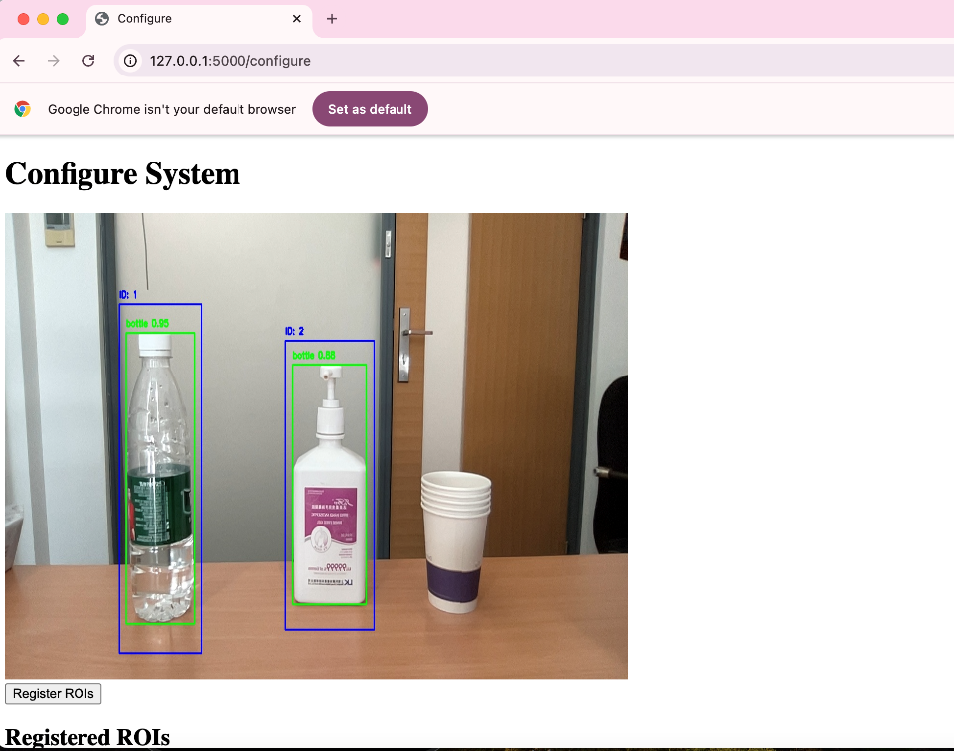
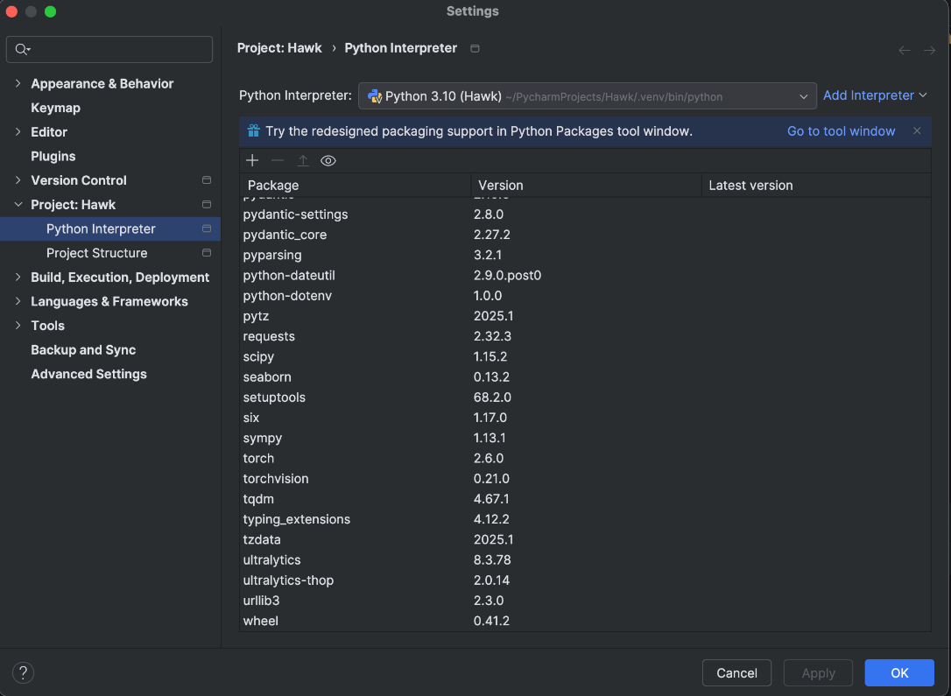
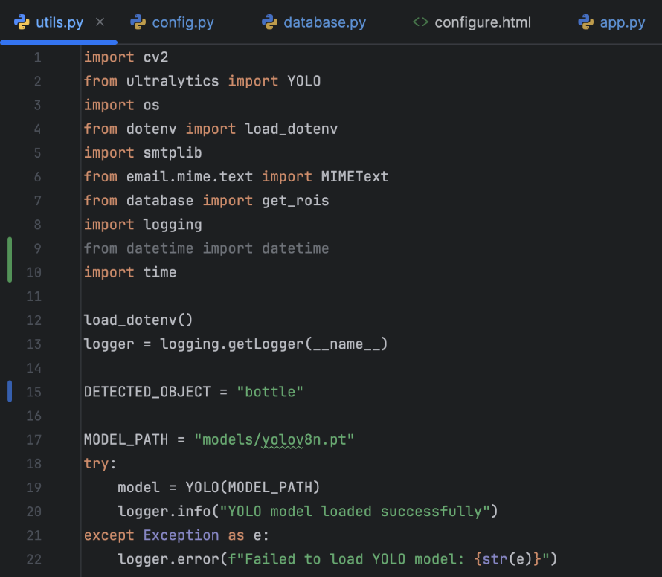
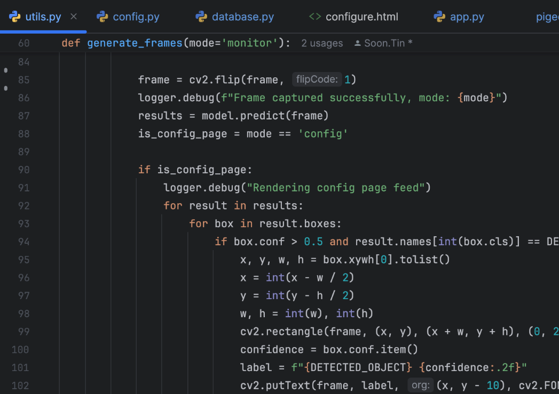
Hands-On: YOLO in Object Classification
2. Import the component
1. Include the dependency
4. Reuse the component
3. Declare the component

Slide 14
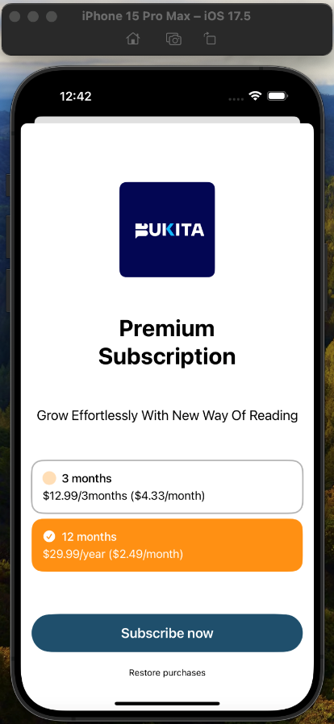
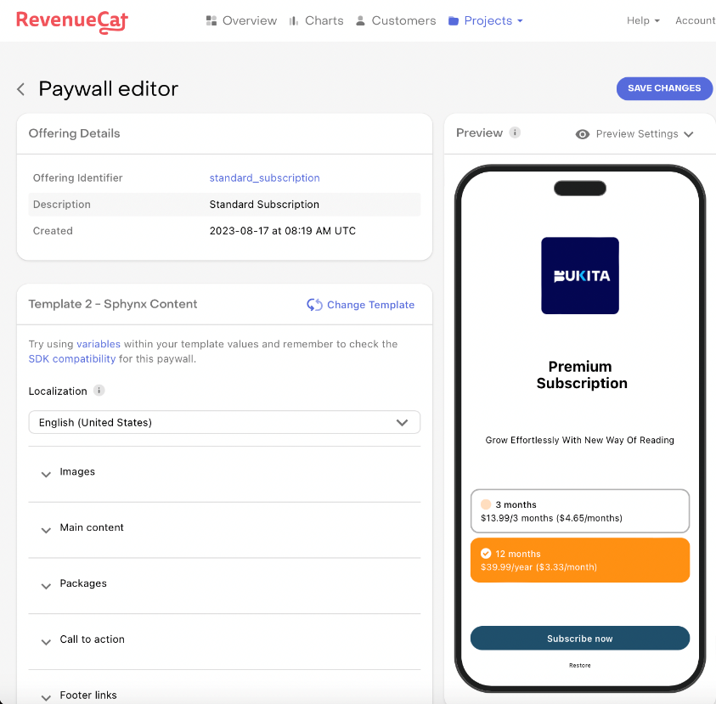
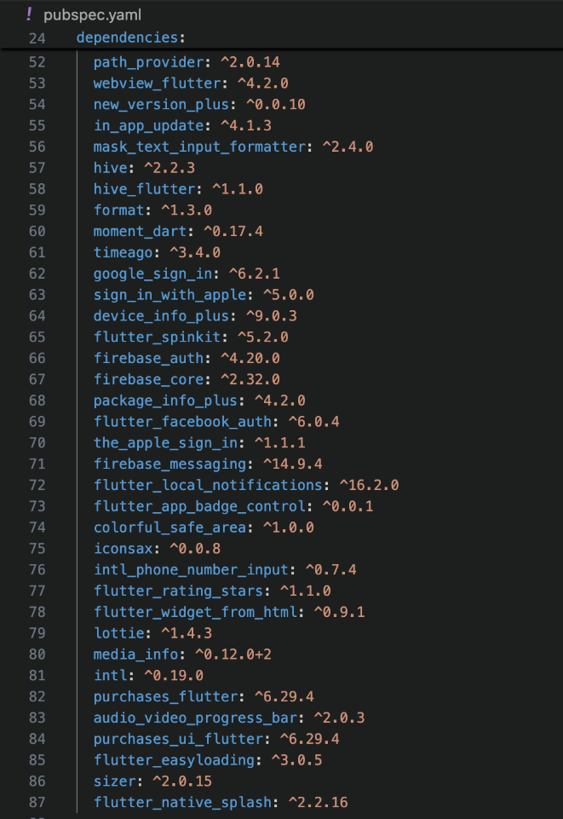
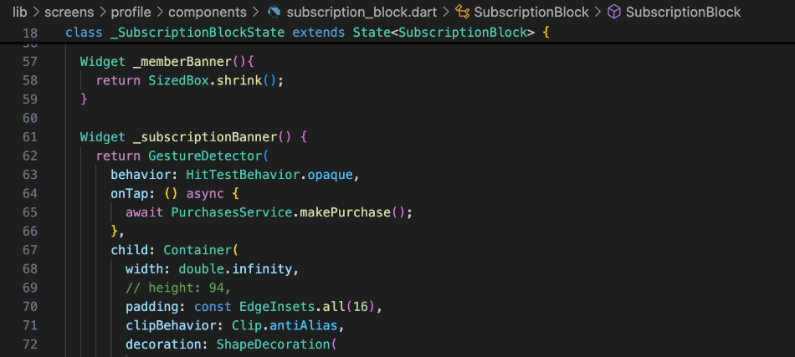
Hands-On: Reuse in Action
2. Include the dependency
4. End result
3. Reuse the component
1. Define the Paywall

Slide 15
Application Framework
Application framework: Build on a solid foundation
Definition: A generic structure (e.g. a set of classes) that you extend to create specific applications
Examples:
Web framework: Django (Python), Spring (Java)
Mobile framework: Flutter (cross-platform apps)

Slide 16
Application Framework
Frameworks are like pre-built foundations. You save time from starting from the scratch by adding your customize features to the foundations.
How they work: Provide common features (e.g., security, database support) that you customize.
Analogy: Think of a framework as a house’s basic infrastructure such as plumbing, electricity, roofing and wall. You can design the details and add your own fitting.

Slide 17
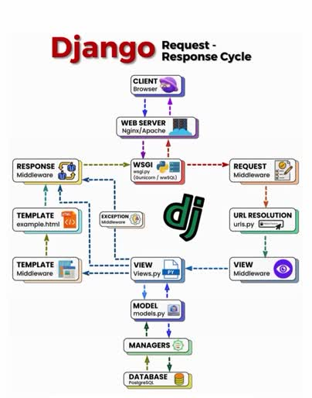

Slide 18
Extending Framework
Extension methods:
Inheritance: Create subclasses from framework classes.
Callbacks: Register functions to be called at specific times or events.
Hooks: Insert custom code at predefined points.

Slide 19
Mini Research
Imagine you’re building a dynamic web app—say, a live music playlist editor—using a framework like React or Django. Your app needs to respond to user actions and lifecycle events. Dive into the roles of callbacks and hooks: how do they work in a web framework, and what sets them apart in bringing your app to life?

Slide 20
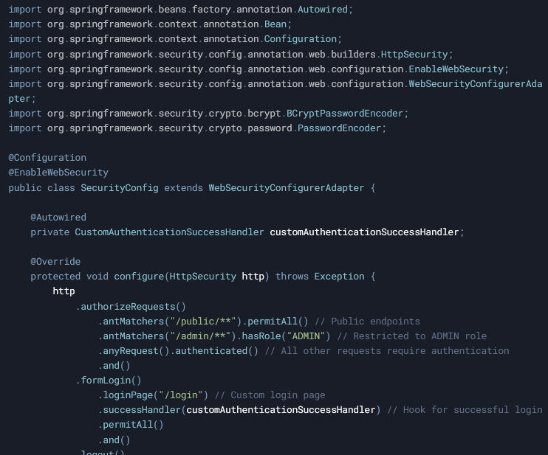
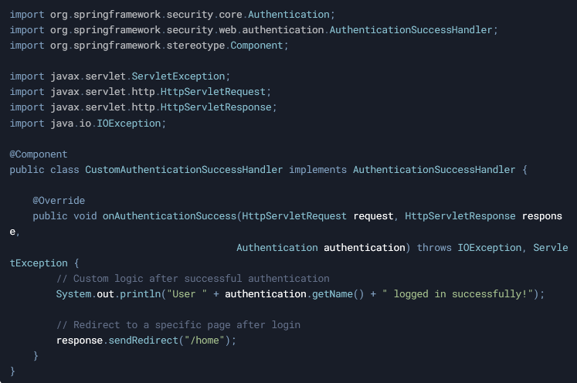
Extending Framework
Example for the implementation of hook in Spring framework

Slide 21
Chanllenges of Application Framework
Learning Curve: Steep initial effort to understand and adapt the framework (e.g., mastering Django’s structure).
Overhead: May include unused features, bloating the app (e.g., extra libraries in React).

Slide 22
Application Framework vs. Libraries
Application Frameworks:
Structure for entire apps (e.g., Django).
Controls flow—you extend it.
Software Libraries:
Tools for specific tasks (e.g., Requests).
You control flow—call as needed.

Slide 23
 | Application Framework | Software Library
Definition | A pre-built, reusable structure or skeleton that provides a foundation for developing applications. Django (web apps), Spring (enterprise apps) | A collection of reusable functions, classes, or utilities that developers call to perform specific tasks NumPy (math operations), jQuery (DOM manipulation)
Control Flow | Uses an inversion of control (IoC) model—the framework controls the flow. Developers plug their code into predefined entry points (e.g., hooks, callbacks) dictated by the framework. | The developer retains control—you call the library when you need its functionality
Scope and Scale | Broad scope, often covering an entire application domain | Narrower scope, focusing on specific tasks or features
Customization | Customization happens within the framework’s constraints—developers extend or override its predefined behaviors | More flexible—developers use only what they need and integrate it however they want, with no imposed architecture.
Dependency | Your application depends heavily on the framework; it’s the backbone of the system, and removing it would require a major rewrite. | Dependency is lighter—you can swap out or remove a library with less impact, as it’s not integral to the app’s structure.

Slide 24
Software Product Lines (SPL)
Building a family of products
Definition: A set of related software products sharing a common core but specialized for different needs.
Example: Salesforce offer CRM variant for sales, support, and marketing all built from one SPL

Slide 25
Software Product Lines (SPL)
Benefits:
Reuse across multiple products
Faster development for new variants
Analogy: Car models with different features, but using the same engine under the hood
SPLs are ideal when you need to create similar products with slight variations. The reuse in SPL is at the domain level.

Slide 26
SPL Specializations
Type of specialization | Description | Example
Platform specialization | Adapt for different devices | Web, mobile, embedded
Functional specialization | Add features for specific users | Sales, support
Environment specialization | Adjust for different operating environment | High-security, standalone
Process specialization | Support different workflow | Cash payment, credit card, debit card

Slide 27
Challenges for SPL
Upfront Investment: High cost and time to design a reusable core (e.g., defining shared CRM features).
Complexity: Managing variants can get messy as the family grows (e.g., updating all apps consistently).

Slide 28
Exercise
A software development team is tasked with creating a fitness tracking application that supports multiple user roles (athletes, coaches, health professionals), includes workout planning features, and integrates with external wearable devices (e.g., Fitbit). The client demands delivery within five months and prioritizes maintainability.
Complete the following structured short-answer questions based on the scenario:
Name one software reuse technique suitable for this project.
State two reasons why the technique you chose in part 1) is suitable for this project.

Slide 29
Commercial Off-The-Shelf (COTS)
Ready-made software for quick deployment
Definition: Pre-built software that you can buy and adapt without changing the source code
Example: WordPress for websites, HubSpot for CRM, SAP for ERP

Slide 30
Commercial Off-The-Shelf (COTS)
COTS can be tailored by
Configure settings
Plugins
API calls
Benefits:
Fast deployment
Lower development risk
Vendor support

Slide 31
COTS vs. SPL
COTS | SPL
Single product for broad use Limited customization Ready to use | Family of products for specific domains Highly customizable Requires upfront works
Customer don’t buy the SPL; They buy specific products from the family

Slide 32
Salesforce Case Study
Internally, Salesforce develop its range of products using SPL strategy
Market its products as individual COTS product to external customers
An SPL could be packaged and sold as COTS products
However, SPL is not always sold as COTS products

Slide 33
Testing COTS Systems
Testing of COTS focus on integration
Key focus: To test how the COTS software interacts with your operational processes
COTS is pre-tested, but integration with you operation may not smooth
Example:
Ensure the COTS CRM integrates well with your existing email system
Ensure the COTS CRM works coherently with your process to manage customers

Slide 34
Challenges for COTS
Limited Customization: Configuration-only approach restricts flexibility (e.g., WordPress can’t be fully rewritten).
Vendor Dependency: Reliant on vendor updates or support (e.g., delays in fixing SAP bugs).

Slide 35
Exercise
You are a software engineering consultant hired by a company that develops mobile applications for different industries, such as healthcare, finance, and education. The company is considering adopting software reuse techniques to reduce development time and costs while maintaining high quality. They are particularly interested in understanding the differences between Application Frameworks and Software Product Lines (SPL).
Scenario: The company plans to develop a new set of mobile apps for small businesses, including:
A point-of-sale (POS) app for retail stores.
An appointment scheduling app for service-based businesses.
An inventory management app for warehouses.
All apps need to run on both iOS and Android, and they must share common features like user authentication, payment processing, and data analytics.

Slide 36
Exercise
Tasks:
Define Application Frameworks and Software Product Lines (SPL), highlighting their key differences.
Recommend which technique (Application Frameworks or SPL) is more suitable for the company’s needs. Justify your choice with at least three specific reasons based on the scenario.
Identify two potential challenges the company might face when implementing your recommended technique.

Slide 37
Discussion
For each strategy (Application Framework, SPL, and COTS), explain how it tackles at least two of the essential difficulties discussed in the essay written by Fred Brooks “No Silver Bullet”, using examples to show your strategy in action.
Your task is to challenges the below given answer.

Slide 38
Discussion Answer
Application Frameworks:
Complexity: Frameworks like Django reduce complexity by providing a structured blueprint—pre-built modules for carts, payments, and user accounts simplify the app’s design. Instead of juggling chaotic code, you follow a clear MVC pattern.
Changeability: They handle evolving needs well; adding a new payment gateway (e.g., Stripe) is just a matter of plugging into Django’s extensible architecture via middleware or apps.

Slide 39
Discussion Answer
Software Product Lines (SPL):
Complexity: SPLs tame complexity by creating a reusable core (e.g., shared checkout and inventory logic) for variants like mobile and desktop e-commerce apps, reducing redundant design work.
Conformity: They align with real-world constraints by specializing the core—e.g., a mobile version conforms to touch inputs, while desktop supports keyboard navigation, all from one base.

Slide 40
Discussion Answer
COTS:
Complexity: COTS like Shopify slashes complexity—you get a pre-built e-commerce solution with carts and analytics out of the box, no need to design from scratch.
Changeability: It adapts to changes via configuration (e.g., adding a discount feature through plugins), though major shifts might hit customization limits.

Slide 41
Reuse in the Real World
Overview: Netflix reuses micro-services across its platform
Benefit:
Scalability: Reuse services enable Netflix to
Handle million of users by adding more micro-service instances to a specific Netflix service
Easily add new Netflix service using existing micro-services
Reliability: Tested micro-services can be reused without testing again

Slide 42
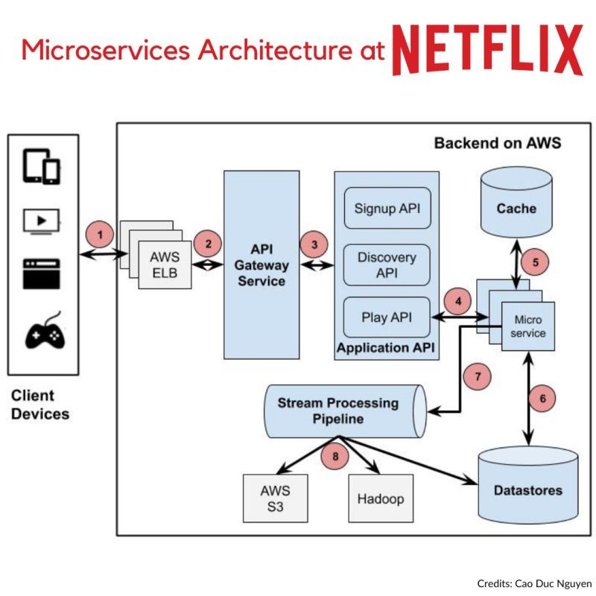
Reuse in the Real World
Scalability means growing without breaking
Reuse micro-services enable Netflix to add more service instances and servers without disrupting users
Flexibility: Deploy and scale individual services (e.g., adding more streaming instances during peak times) without affecting others.

Slide 43
Reuse in the Real World
Around 2016-2017, Netflix was reported to have approximately 700 microservices, as noted in articles from the Netflix TechBlog.
A 2023 article from the Netflix TechBlog and a GeeksforGeeks post from 2024 suggest that Netflix now operates with hundreds, if not thousands, of microservices
Based on the best available data and logical extrapolation, Netflix likely has approximately 1,000 to 1,500 microservices

Slide 44
Why Reuse Matters
Summary
Reuse saves time, money, and effort.
Techniques like frameworks, SPL, and COTS offer different ways to reuse.
Real-world companies rely on reuse to stay competitive.
As software engineers, mastering reuse will make you more efficient and valuable.
How can you apply reuse in their own projects?

Slide 45
The End

